Slide 1
High-Performance OCR for Printed English and Fraktur using LSTM Networks

Slide 2
Agenda
Problem Statement
GT4HistOCR Dataset Overview
Challenges
Methodology
Results
Questions

Slide 3
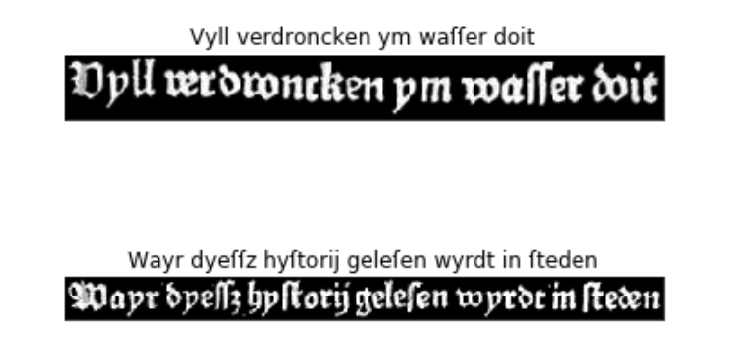
Problem statement
Optical Character Recognition (OCR) for scanned images of historical printings and manuscripts.
No post-processing
No language modelling
Unsegmented image text lines

Slide 4
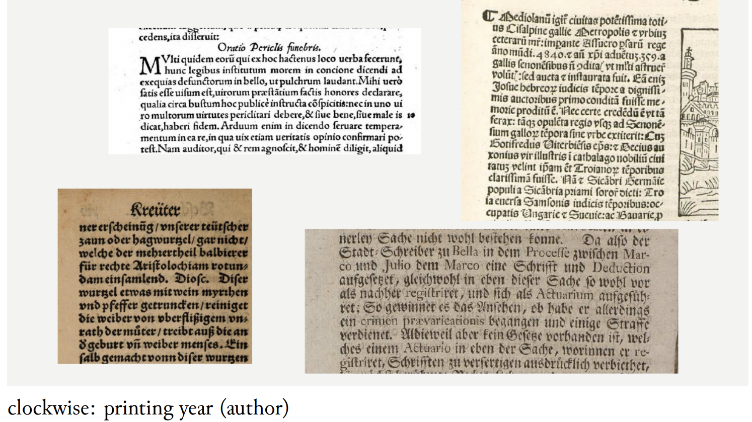


Dataset Overview

Slide 5
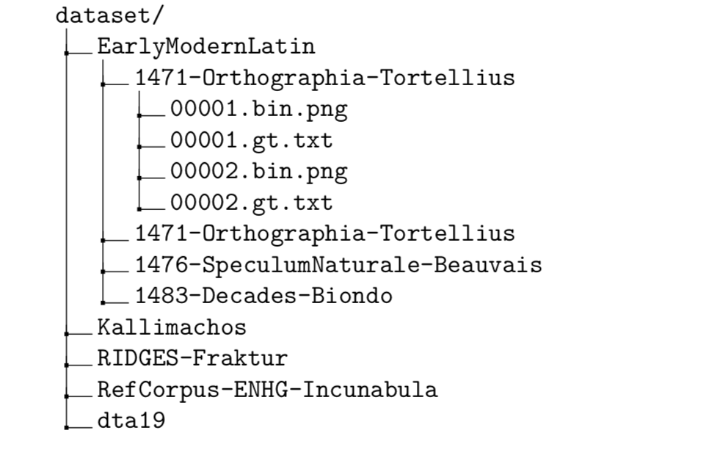
Dataset Overview
Consits of five subcorpora
Samples: 313,173
Language: German and Latin
Fonts: Fraktur (ger), Antiqua (latin)
Time: between 15th and 19th century

Slide 6
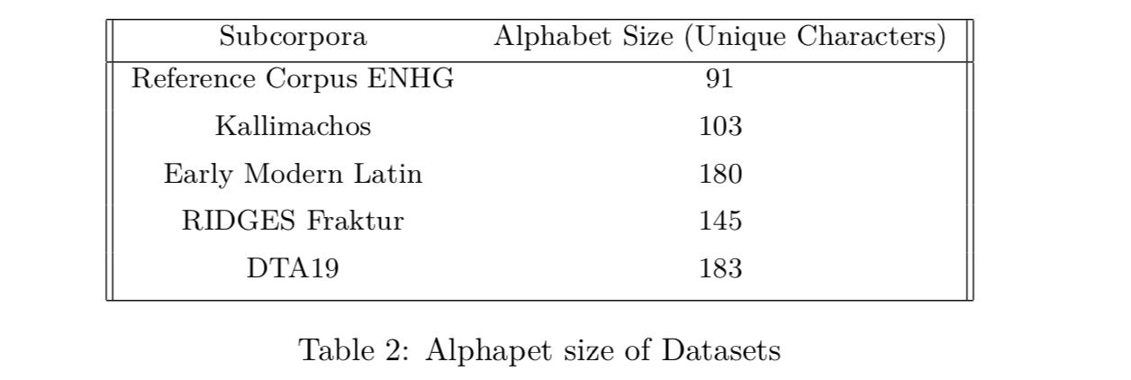
Alphapet size of Datasets

Slide 7
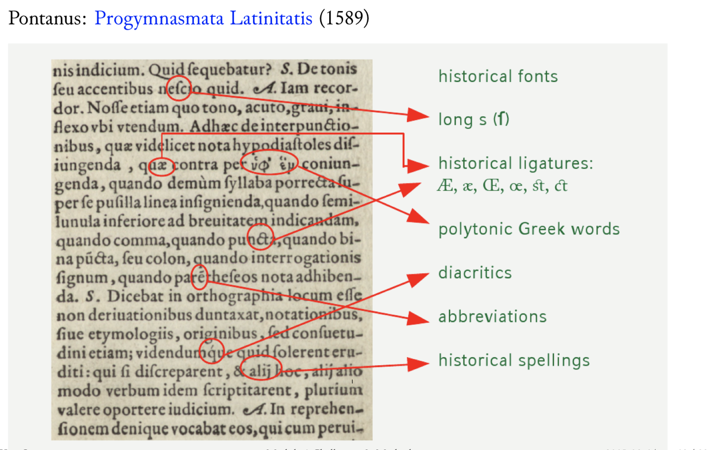
Challenges
Historical fonts
Special glyphs
Historical spellings
Rare characters

Slide 8


Slide 9
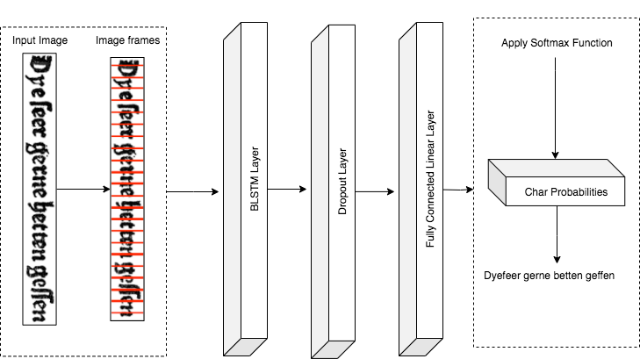
Model architecture

Slide 10
Model Output
 | F1 | F2 | F3 | F4 | F5 | F6
a | 0.1 | 0.2 | 0.3 | 0.9 | 0.0 | 0.3
b | 0.0 | 0.1 | 0.1 | 0.0 | 0.0 | 0.0
c | 0.4 | 0.3 | 0.1 | 0.0 | 0.1 | 0.1
d | 0.3 | 0.1 | 0.2 | 0.0 | 0.2 | 0.1
t | 0.1 | 0.2 | 0.2 | 0.1 | 0.7 | 0.3
z | 0.1 | 0.1 | 0.1 | 0.0 | 0.0 | 0.2

Slide 11
Model Output
 | F1 | F2 | F3 | F4 | F5 | F6
a | 0.1 | 0.2 | 0.3 | 0.9 | 0.0 | 0.3
b | 0.0 | 0.1 | 0.1 | 0.0 | 0.0 | 0.0
c | 0.4 | 0.3 | 0.1 | 0.0 | 0.1 | 0.1
d | 0.3 | 0.1 | 0.2 | 0.0 | 0.2 | 0.1
t | 0.1 | 0.2 | 0.2 | 0.1 | 0.7 | 0.3
z | 0.1 | 0.1 | 0.1 | 0.0 | 0.0 | 0.2
ccaatt
cat
aappppllee
?

Slide 12
Blank char
Add a blank char to the alphabet ( e.g. $ )
Insert the blank char between target text characters : $a$p$p$l$e$
Predict text : $$aa$$pp$$pp$$ll$$ee$$
Remove consecutive repeated chars : $a$p$p$l$e$
Drop the blank char : apple

Slide 13
Connectionist Temporal Classification (CTC)
DP algorithm that calculate the loss based on probability sequence of the alphabet.
Doesn’t require a predefined alignment between the input frames and the output labels.
Input: probabilities associated with the frames (i.e. model output)
Output: the joint probability distribution of the correct frames labelling

Slide 14
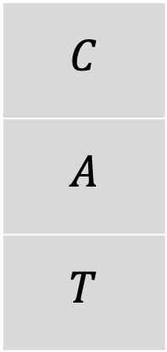
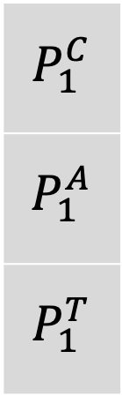
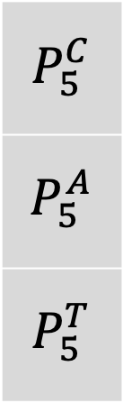
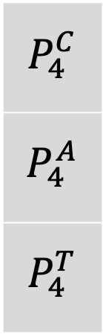
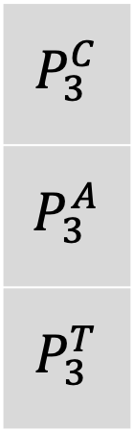
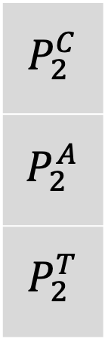
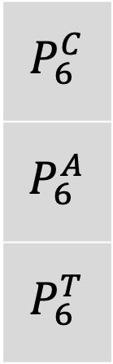
Connectionist Temporal Classification (CTC)
Target Text
T1
T2
T3
T4
T5
T6
$$C$$
$$A$$
$$T$$
$$P_{1}^{C}$$
$$P_{1}^{A}$$
$$P_{1}^{T}$$
$$P_{2}^{C}$$
$$P_{2}^{A}$$
$$P_{2}^{T}$$
$$P_{3}^{C}$$
$$P_{3}^{A}$$
$$P_{3}^{T}$$
$$P_{4}^{C}$$
$$P_{4}^{A}$$
$$P_{4}^{T}$$
$$P_{5}^{C}$$
$$P_{5}^{A}$$
$$P_{5}^{T}$$
$$P_{6}^{C}$$
$$P_{6}^{A}$$
$$P_{6}^{T}$$
Time Steps
$P_{1}^{C}$ : the probability associated with the letter C in the model output at the first time step

Slide 15
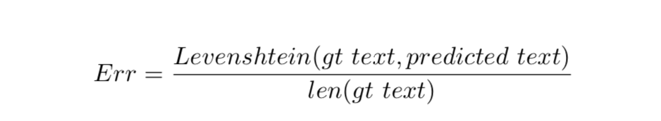
Dataset splitting
Select one book as holdout.
Split the remaining books to ( 80% training, 20% test ).
Report the Levenshtein Error on ( train, test, holdout ) datasets.

Slide 16
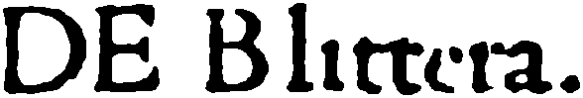
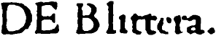
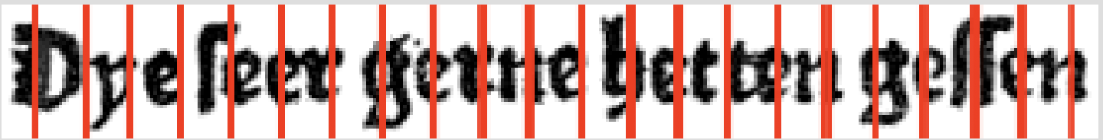
Transformations
Image thumbnail transformation.
Image padding transformation.
Unfold image transformation.

Slide 17
Hyperparameters
Frame size
Hidden layers number
Hidden layer size
Learning rate
Batch size
Dropout ratio
Clipping value
Momentum
Epochs

Slide 18


Slide 19
Reference Corpus ENHG
HL Size | HL Number | Frame Size | Train Error | Test Error | Holdout Error | Training Time(hrs)
200 | 3 | 1 | 0.006 | 0.016 | 0.054 | 19.8
200 | 3 | 2 | 0.072 | 0.072 | 0.147 | 13.6
100 | 1 | 5 | 0.245 | 0.253 | 0.378 | 13.5

Slide 20
Reference Corpus ENHG
Ground Truth
cleyder die velle van den beisten.
Best Model
cleyder die velle van denbeisten.
Median Model
ceyder die vele van denbeisten.
Worst Model
cerder die vole van den besten
Text Line Image

Slide 21
Early Modern Latin
HL Size | HL Number | Frame Size | Train Error | Test Error | Holdout Error | Training Time(hrs)
150 | 2 | 1 | 0.001 | 0.03 | 0.095 | 13.8
200 | 3 | 3 | 0.0001 | 0.037 | 0.121 | 8.2
100 | 2 | 4 | 0.001 | 0.052 | 0.15 | 5.6

Slide 22
Early Modern Latin
Ground Truth
fscus utraque: coniuncta classe: cõtra populoniæ
Best Model
fscis utraque: coniuncta classe: cõtra populoniæ
Median Model
fsc is utraque: coniuneta classe: cõtra populoniæ
Worst Model
fsc:ais utraque: coniuncta cdasse: cõtra populoniæ
Text Line Image

Slide 23
Efficiency and accuracy
The following aspects introduce a tradeoff between efficiency and accuracy:
Image Thumbnail Transformation
Model Architecture
Frame Size
No language model is needed so the model can be adapted to other languages easily.

